Slide 1
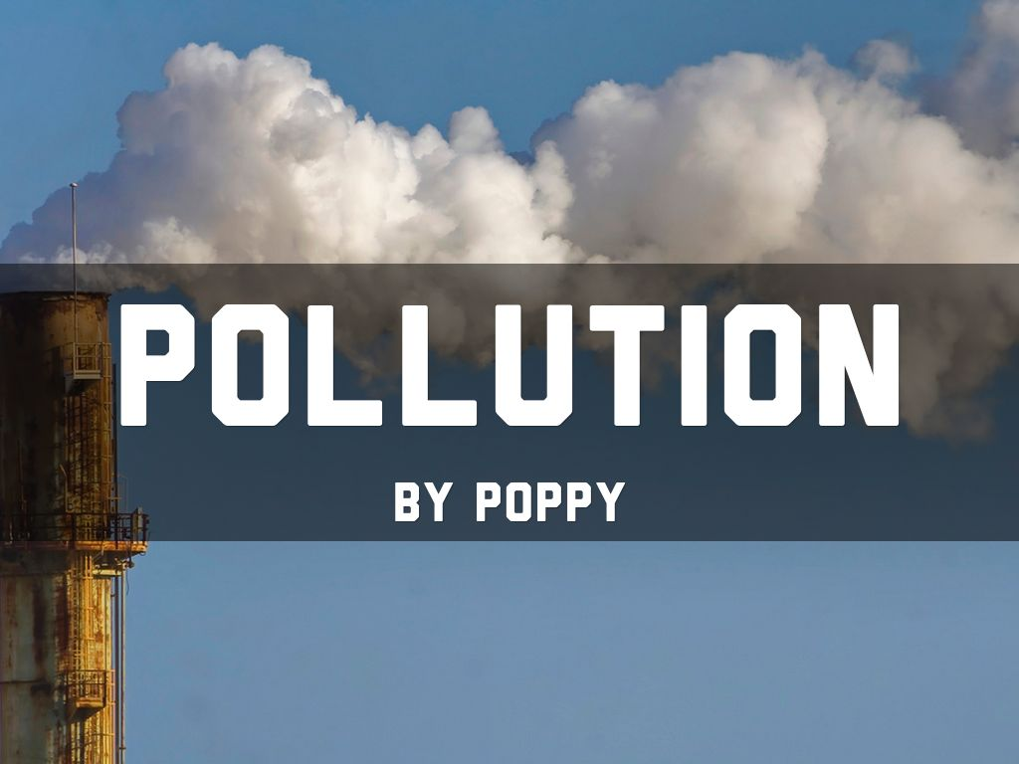

Slide 2
POLLUTION
Pollution can be described as a nutrient or substance that is out of place. More specifically, however, it is the addition of any substance (solid, liquid, or gas) or any form of energy (such as heat, sound, or radioactivity) to the environment at a rate faster than it can be dispersed, diluted, decomposed, recycled, or stored in some harmless form. This infographic defines seven major types of pollution and summarizes the issues connected to them.

Slide 3
TYPES OF POLLUTION
Land pollution
Air pollution
Water pollution
Noise pollution
Plastic pollution
Light pollution
Thermal pollution

Slide 4
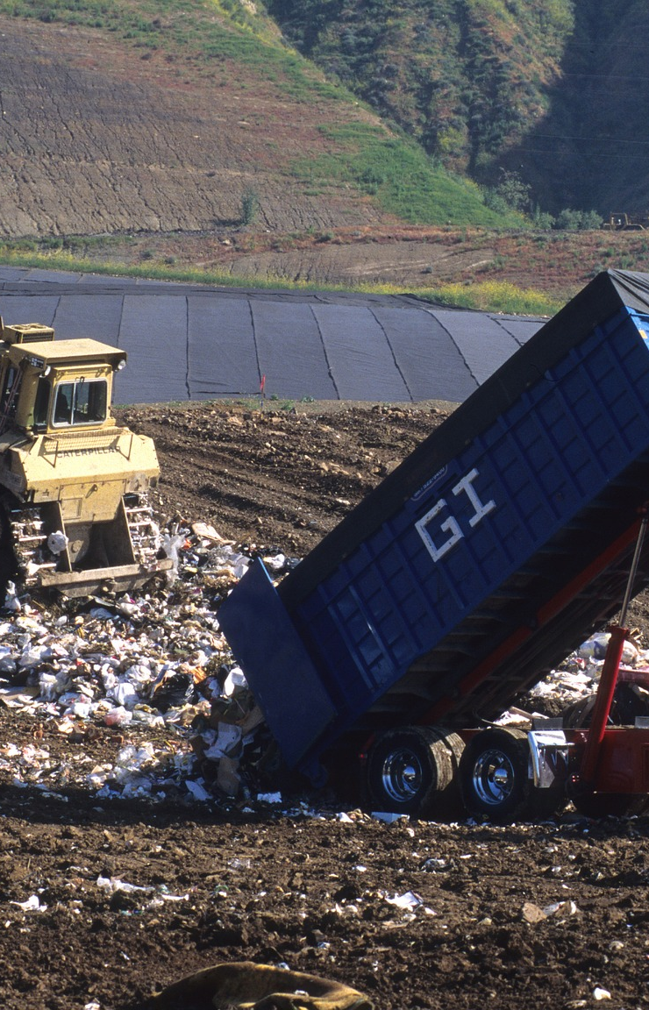
LAND POLLUTION
The basic definition of land pollution is the destruction and contamination of the land through the direct and indirect actions of humans. The pollution results in changes to the land, such as soil erosion. Some of the changes are irreversible, while others are not.
The effects of land pollution do not necessarily appear overnight. It is the result of long-term destruction from human activities. For instance, the damage from chemicals from an oil spill can take months or even years to be fully realized.

Slide 5
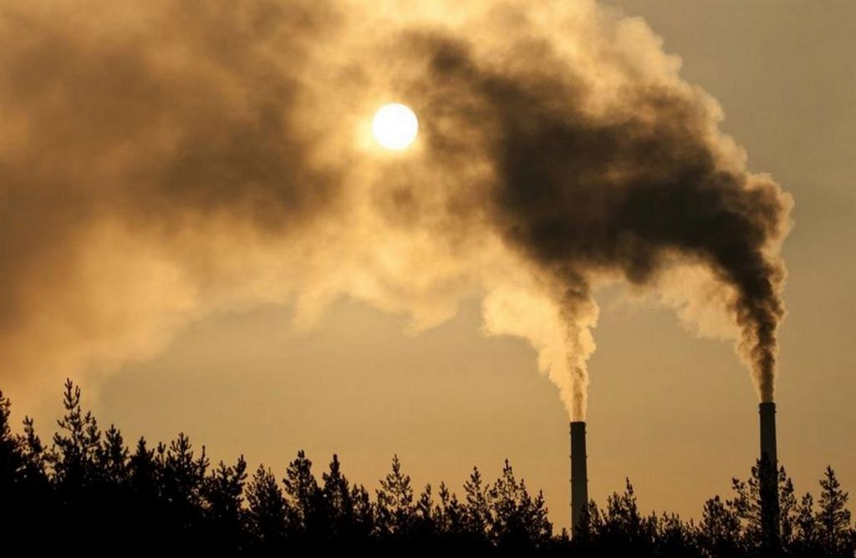
AIR POLLUTION
Air pollution is contamination of the indoor or outdoor environment by any chemical, physical or biological agent that modifies the natural characteristics of the atmosphere. Household combustion devices, motor vehicles, industrial facilities and forest fires are common sources of air pollution. Pollutants of major public health concern include particulate matter, carbon monoxide, ozone, nitrogen dioxide and sulfur dioxide. Outdoor and indoor air pollution cause respiratory and other diseases and are important sources of morbidity and mortality.

Slide 6
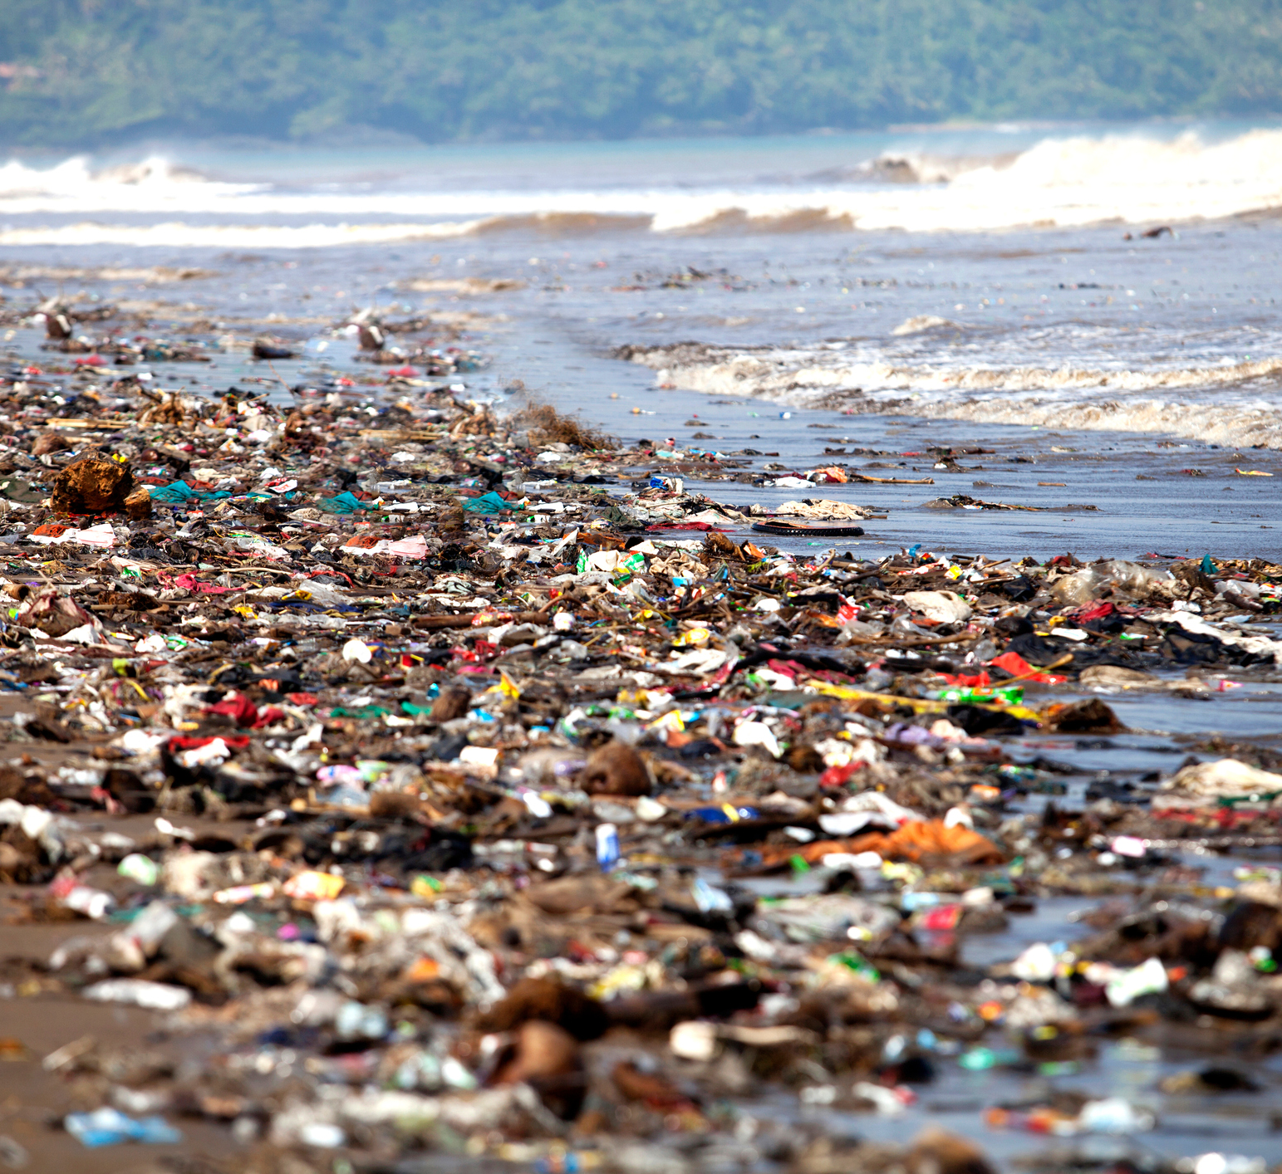
WATER POLLUTION
Water pollution occurs when harmful substances—often chemicals or microorganisms—contaminate a stream, river, lake, ocean, aquifer, or other body of water, degrading water quality and rendering it toxic to humans or the environment. This widespread problem of water pollution is jeopardizing our health. Unsafe water kills more people each year than war and all other forms of violence combined. Meanwhile, our drinkable water sources are finite: Less than 1 percent of the earth’s freshwater is actually accessible to us. Without action, the challenges will only increase by 2050, when global demand for freshwater is expected to be one-third greater than it is now.

Slide 7
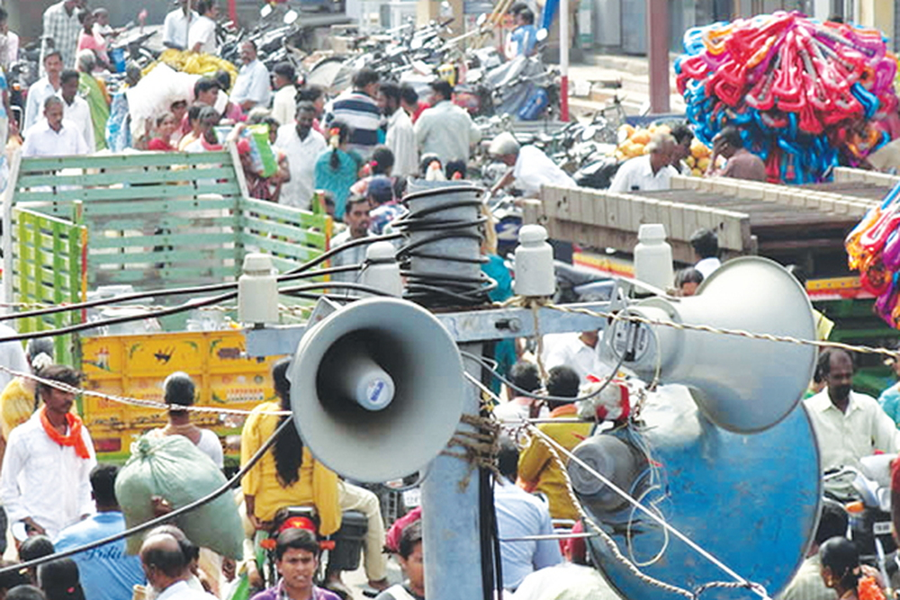
NOISE POLLUTION
Noise pollution is unwanted or excessive sound that affects health and environmental quality. It is caused by machines and engines associated with industry, as well as airports and other transportation systems. Noise is problematic because it can cause physical damage to hearing organs in humans and other animals, it produces increased stress levels, and it disrupts ecosystems by driving certain species away and altering the habits of wildlife. Noise pollution occurs primarily on land located close to industry and transportation and at sea, where it emanates from ship engines and sonar.

Slide 8
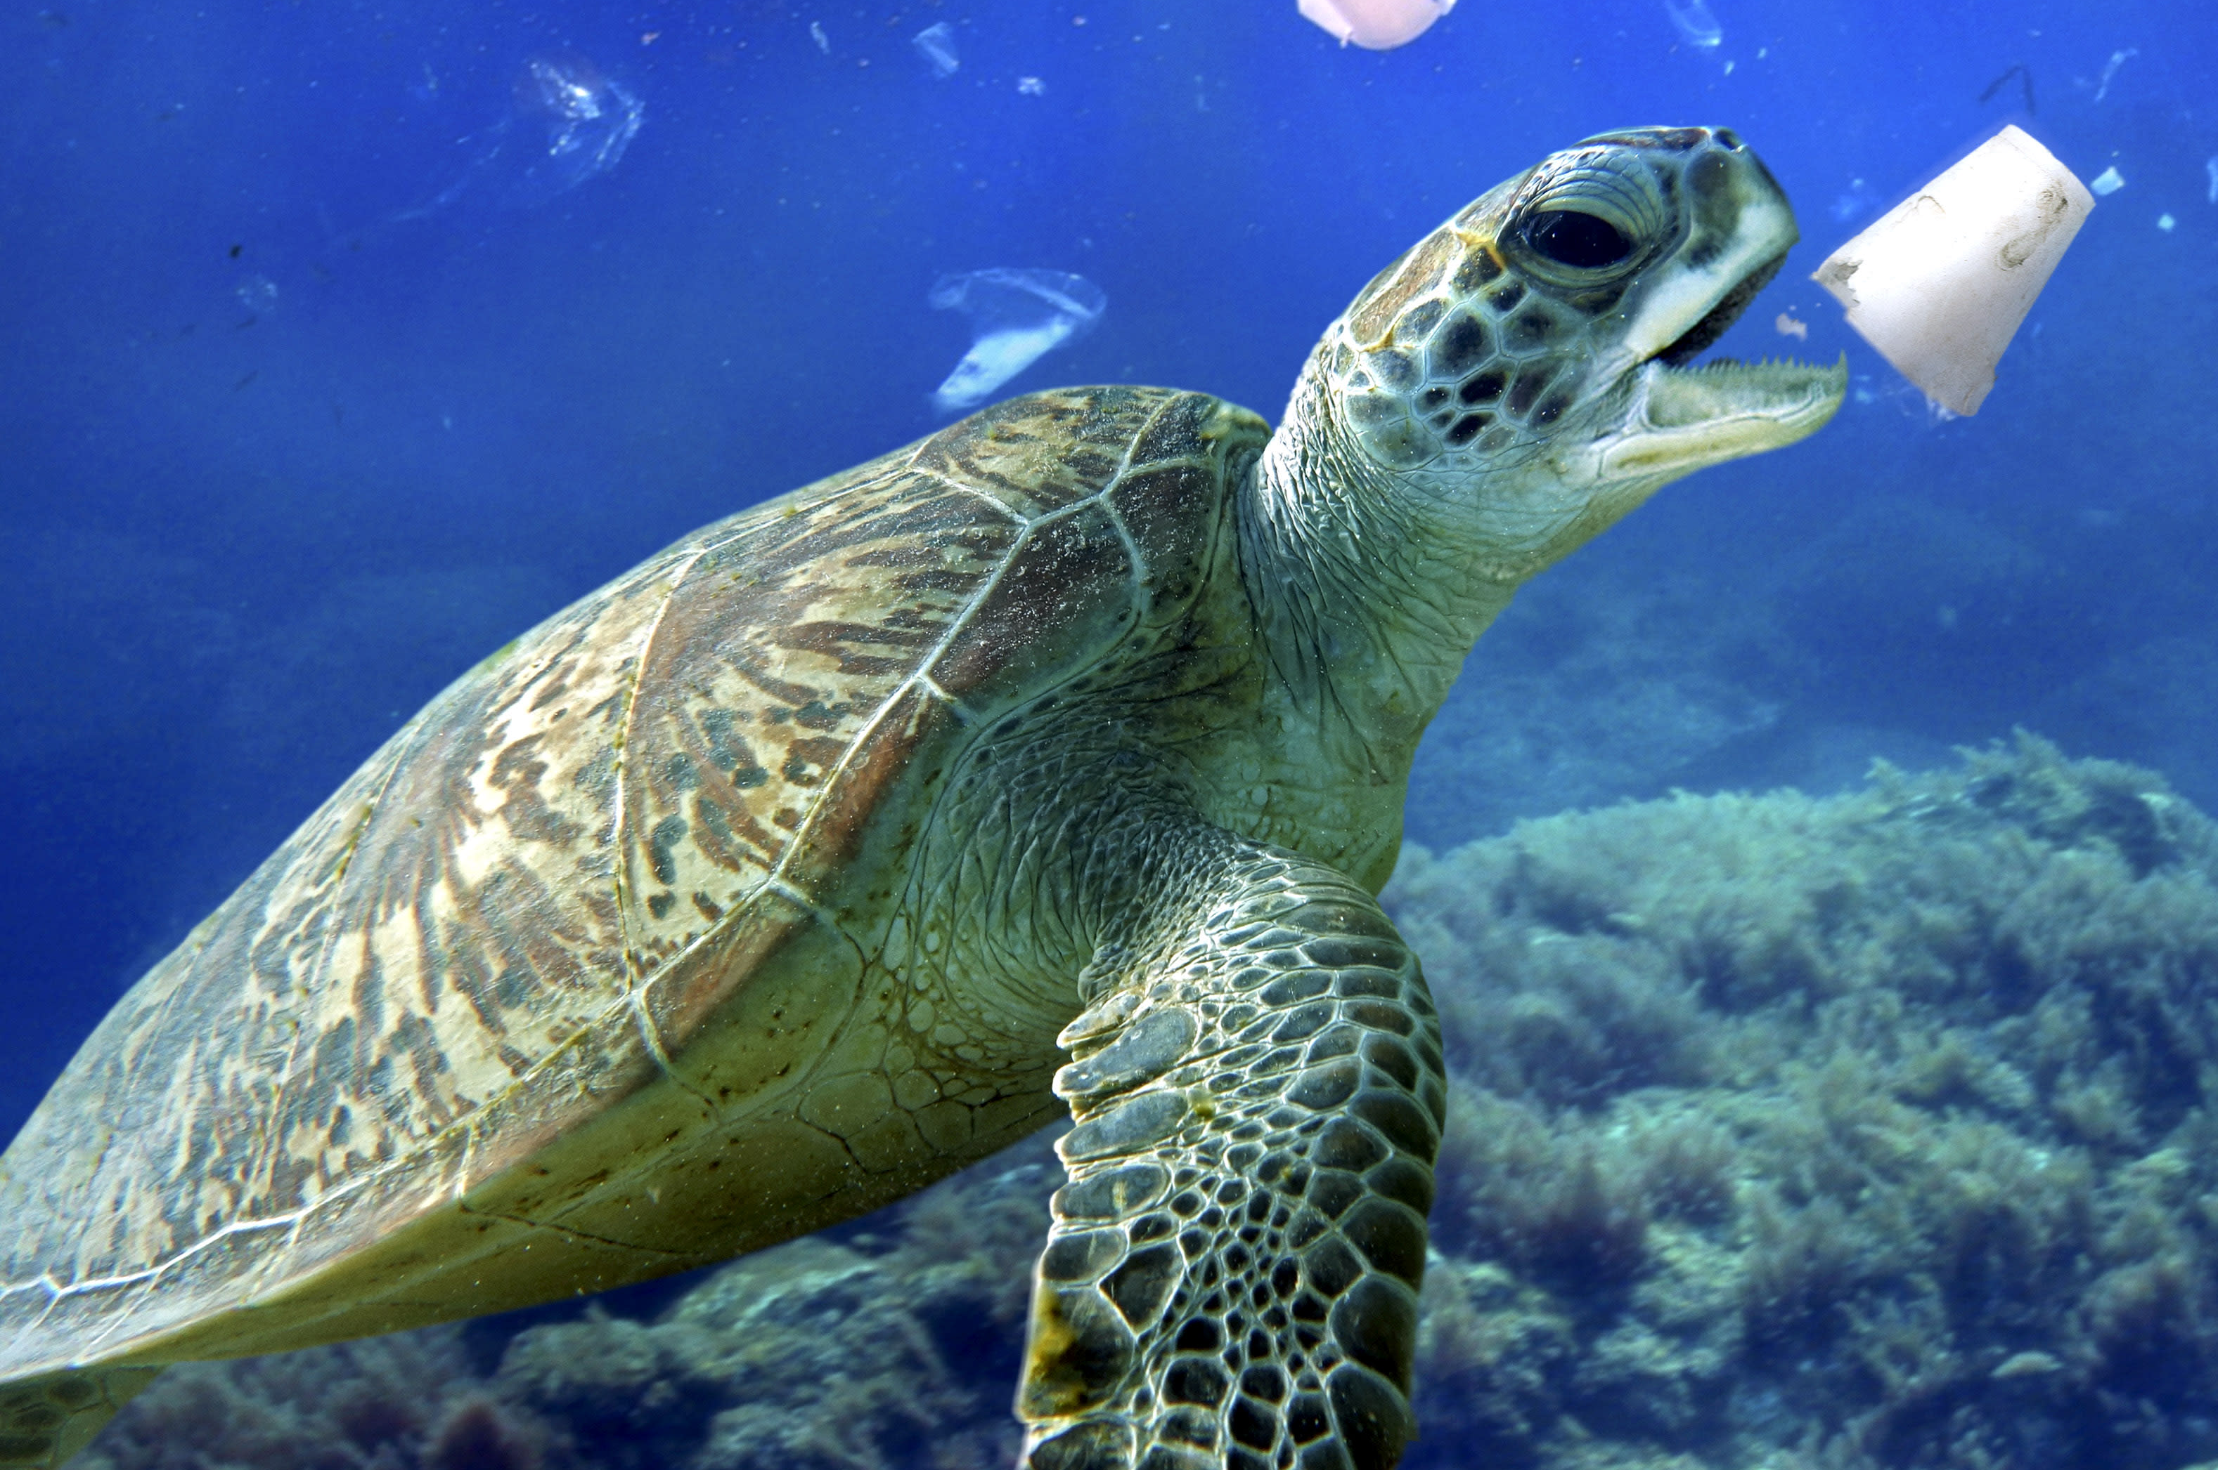
PLASTIC POLLUTION
Plastic pollution is the addition of plastic waste to the landscape and waterways. It is caused by manufactured plastics that are not properly disposed of. It is a problem because plastic does not break down easily, the chemical additives in plastic may become endocrine disrupters, plastic waste flows downstream into rivers and oceans (sea life can ingest, choke on, or become trapped in plastic waste), and plastic is a source of polychlorinated biphenyls (PCBs), which are suspected carcinogens.

Slide 9
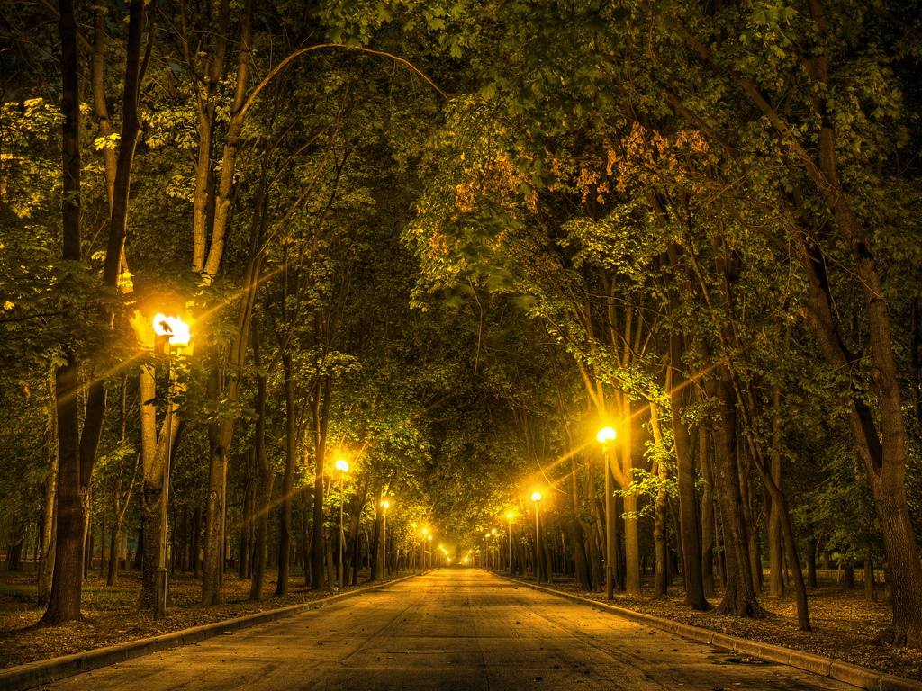
LIGHT POLLUTION
Light pollution is unwanted or excessive light caused by streetlights and illuminated buildings, towers, and other structures. Light pollution changes nighttime visibility of natural features, disorienting migratory animals and fostering bird collisions with lighted towers and buildings.

Slide 10
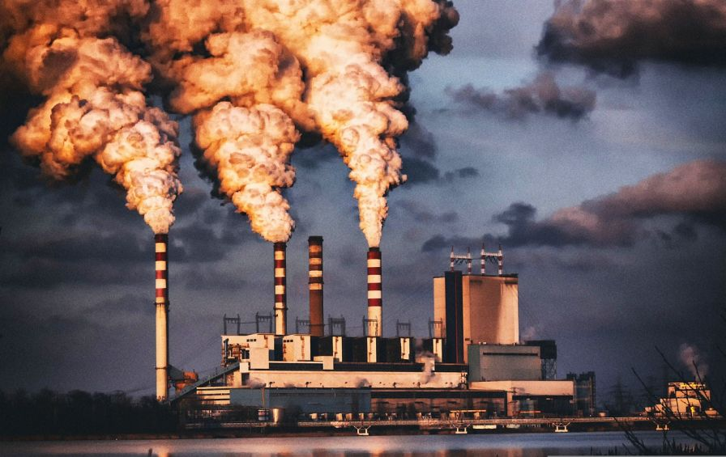
THERMAL POLLUTION
Thermal pollution is the addition of heat to a cool environment, and it is caused by water or air used as cooling fluids in power plants and manufacturing that becomes heated in the process. Heated cooling water from power plants may be 15 ˚C (27 ˚F) hotter than lake or stream water, which increases metabolic rates in fishes and reduces the amount of dissolved oxygen that the water may hold. In extreme cases, it can be hot enough to burn animal tissues.

Slide 11

THANK YOU

